Slide 1

Newell Brands (NWL)
Max McCartney

Slide 2
Buy NWL 6.375% 5/15/30
Investment Summary
Bond Info
Moody’s/S&P/Fitch | B2 (N)/ B+ (S)/NR
Issue Size ($M) | $750
OAS (bps) | 317
YTW | 7.05%
Convexity | 0.15
Modified Duration | 3.51
Thesis 1:
NWL’s restructuring initiatives are streamlining a fragmented operating model, leading to gains in efficiency and working capital management.
Thesis 2:
NWL will accelerate their deleveraging as FCF and revenue prove to be an inflection point in FY25 and are expected to rebound through FY28.
 | Bull | Base | Bear
1Y HPR (Annualized) | 8.78% | 7.83% | 6.63%
Source(s): Bloomberg, FactSet, Company Filings

Slide 3
Company Overview

Slide 4
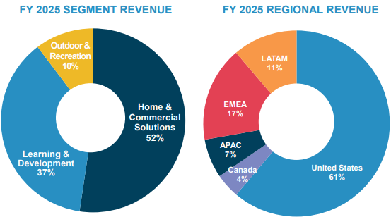
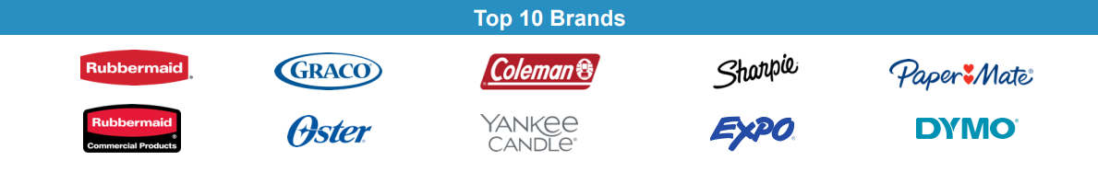
Newell Brands (NWL) is a conglomerate producer of ~55 brands across a range of end markets broken into 3 segments. Since acquiring Jarden Co. in 2016, NWL has been focused on reducing the brand portfolio, product innovation, and improving operations.
Revenue Segments
Operations
Home and Commercial Solutions
Key Products: food storage, cookware, waste/recycling receptacles, and candles.
Learning and Development
Key Products: permanent markers, gel & ballpoint pens, pencils, glue, car seats, and strollers.
Outdoor and Recreation
Key Products: tents, portable power, water bottles, outerwear, cooking gear and cold storage systems.
Source(s): Bloomberg, FactSet, Company Filings

Slide 5
NWL’s revenue mix is driven by H&CS (~50%) followed by L&D (~40%) and O&R (~10%). Gross margin is up 380 bps since 2022, highlighted by a 609 bp gain in O&R.
Source(s): Bloomberg, FactSet, Company Filings

Slide 6
Upgrade and Downgrade Triggers
Moody’s (B2/Negative) | S&P (B+/Stable)
Upgrade Triggers: EBITDA margin grows to mid-teens FCF/Debt sustained at minimum 4% Total Debt/EBITDA below 5.0x | Upgrade Triggers: Leverage is sustained below 5.0x
Downgrade Triggers: Total Debt/EBITDA sustained above 6.0x Lack of comfortable FCF Revenue and/or EBITDA fail to grow | Downgrade Triggers: Debt/EBITDA is sustained above 6.0x FOCF (FFO – CapEx) turns negative
Source(s): Bloomberg, FactSet, Company Filings

Slide 7
Investment Thesis

Slide 8
Thesis Point 1: NWL’s restructuring initiatives are streamlining a fragmented operating model, leading to gains in efficiency and working capital management.
Consolidated Supply Chain​
NWL has merged 23 independent supply chains onto 1 central network, allowing for customers to order across different brands in one space and reducing the suppliers needed. Production has shifted to 57% of products made domestically, with Chinese production declining from 35% to 10%. A global network of 42 plants allow for production flexibility. A new ERP system covering 95%, up from 35%, of the business will be completed by Fall 2026 to integrate supply chain with retailers and implement AI across the enterprise.
Inventory Management​
SKUs dropped 80% to 20k units, cutting out 50% of SKUs that were 2% of sales.​ E&O inventory has declined by 50%, reducing products that never get sold. Production lead time has dropped by 10 days, slimming required inventory held.
Distribution Gains
International distributors are down 40%, leading to fewer moving pieces. ​ Suppliers have reduced 25% since 2022, simplifying the ordering process. Order fill rate of 96% for FY25 was achieved as a result, highest since 2016.
Source(s): Bloomberg, FactSet, Company Filings

Slide 9
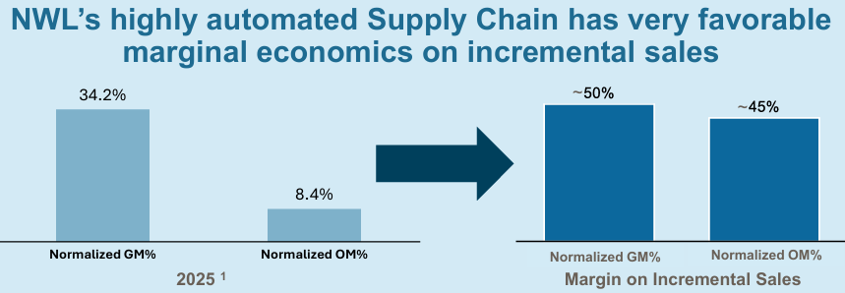
Thesis Point 1: Margins have runway for growth beyond the realized restructuring gains.
Pre-restructuring, NWL was worst in class for capability set among competitors.
​ | 2021​ | 2022​ | 2023​ | 2024​ | 2025​ | 2026E​ | 2027E​ | 2028E​
Gross Margin​ | 31.1%​ | 30.0%​ | 28.9%​ | 33.6%​ | 33.8%​ | 34.1%​ | 34.2%​ | 34.4%​
Management has set a normalized GM of 37-38% and Normalized OM of 12-15% post-restructuring, driven through operating efficiencies and reduced overhead expenses.
Source(s): Bloomberg, FactSet, Company Filings

Slide 10
Thesis Point 2: NWL will accelerate their deleveraging as FCF and revenue prove to be an inflection point in FY25 and are expected to rebound through FY28.
Inflection in Sales driven by Innovation
Improved Liquidity through FCF & EBITDA
NWL is scheduled to launch 25 Tier 1 products in FY26, up from 17 in 2025 and 8 in 2024.
New launches are boosted by core products hitting their “replacement window” across all segments as products complete their lifecycle.
2026 is expected to be the first positive shelf distribution year since 2016 for NWL brands.
FCF is expected to recover through improvements in working capital and sales.
S&P upgraded NWL’s liquidity profile to SGL-3 on Nov. 25 to show adequate liquidity and improving conditions.
EBITDA margin expected sustain growth, accelerating the deleveraging process.
Increasing revenues across segments should drive adjusted EBITDA margins towards 12% with leverage expected to decline to 4.3x.
Source(s): Bloomberg, FactSet, Company Filings
Notes:
. 70% of Tier 1 launches have met or beat expectations for revenues earned and market share gained. Contigo, Yankee, Chesapeake all relaunching this year. 2026E EBITDA boosted by expected restructuring expense added back. Increasing A&P for the next few years.

Slide 11
Risks and Mitigants
Risks
Mitigants
Decline in Consumer Spending Stunts Recovery
NWL’s “good/better/best” product tiering hedges declines in spending as consumers across all income levels have access to affordable options.
Product Launches Fail, Diluting Margins
NWL’s tiered innovation system concentrates spending on their highest conviction bets, with 70% of Tier 1 products meeting or beating expectations since 2023.
Refinancing Raises Interest Costs on Unfavorable Terms
NWL’s 2Q25 debt issuance of $1.25B was 4x oversubscribed, signaling strong creditor demand that positions NWL to refinance at competitive rates.
Source(s): Bloomberg, FactSet, Company Filings

Slide 12
Valuation

Slide 13
Newell Brands Credit Profile vs. Industry Peers
​ | Central Garden & Pet Co. (CENT) ​ | Spectrum Brands (SPB)​ | Newell Brands (NWL) | Acco Brands (ACCO)​
Ratings (Outlook)​ | B1/BB/BB ​ (S/S/S)​ | B2/B+/BB ​ (S/S/S)​ | B2/B+/NR ​ (Neg/S/NR) | B2/B/BB- ​ (S/Neg/Neg)
Market Cap​ | $2.1bn​ | $1.8bn​ | $1.9bn​ | $364mm
Revenue (LTM)​ | $3.1bn​ | $2.8bn​ | $7.2bn​ | $1.5bn​
EBITDA (LTM)​ | $337mm ​ | $363mm​ | $826mm ​ | $197mm ​
EBITDA Margin​ | 10.9%​ | 13.0%​ | 11.5% | 12.8%​
EV/EBITDA​ | ​7.6x | ​6.4x | 7.7x | 6.3x​
Total Debt (LTM)​ | $1.43bn​ | $655mm​ | $4.17bn | $963mm​
Free Cash Flow​ | $231mm​ | $305mm | $17mm​ | $54mm​
Total Debt/EBITDA​ | 6.9x​ | 1.8x​ | 5.7x | 4.9x
Net Debt/EBITDA​ | 6.4x​ | 1.5x​ | 5.5x​ | 4.5x​
Source(s): Bloomberg, FactSet, Company Filings

Slide 14
Comparable Bonds
​ | CENT 4.125% 10/15/2030 | SPB 3.875% 3/15/2031 | NWL 6.375% 5/15/2030​ | ACCO 4.25% 3/15/2029​
Ratings (Outlook)​ | B1/BB/BB (S/S/S) | B2/B+/BB (S/S/S)​ | B2/B+/NR ​ (Neg/S/NR) | B2/B/BB- ​ (S/Neg/Neg)
Rank​ | Sr. Unsecured​ | Sr. Unsecured​ | Sr. Unsecured​ | Sr. Unsecured​
Price​ | 95.77​ | 87.41 | 97.59 | 91.8
Amount Outstanding​ | 500mm​ | 128mnm | 750mm​ | 575mm ​
Modified Duration​ | 4.05 | 4.32 | 3.51 | 2.69​
YTW​ | 5.17%​ | 6.89%​ | 7.05%​ | 7.33%
OAS​ | 140 bps​ | 316 bps​ | 317 bps​ | 374 bps​
5Y CDS​ | N/A​ | NA​ | 321 bps​ | NA​
Source(s): Bloomberg, FactSet, Company Filings
Notes:
Better liquidity than competitors. Shorter mod. Duration and comparable ytw.

Slide 15
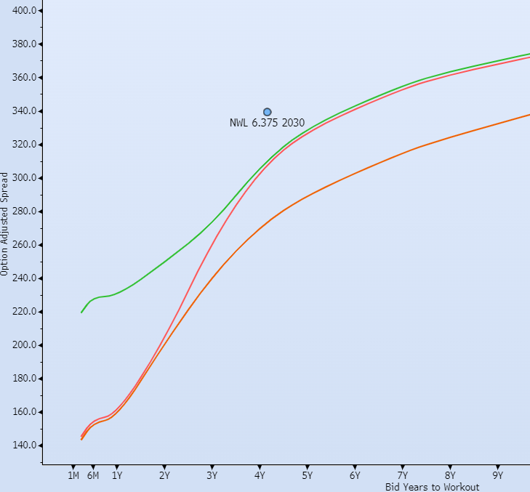
NWL 30s Offer an Attractive 1Y Holding Period Return With a Skew to Upside
​ | Bull​ | Base​ | Bear​
∆OAS​ | - 60 bps​ | - 25 bps​ | + 20 bps​
1Y HPR (Annualized)​ | 8.78%​ | 7.83%​ | 6.63%​
Source(s): Bloomberg, FactSet, Company Filings

Slide 16
Buy NWL 6.375% 5/15/30
Investment Summary
Bond Info
Moody’s/S&P/Fitch | B2 (N)/B+ (S)/NR
Issue Size ($M) | $750
OAS (bps) | 317
YTW | 7.05%
Convexity | 0.15
Modified Duration | 3.51
Thesis 1:
NWL’s restructuring initiatives are streamlining a fragmented operating model, leading to gains in efficiency and working capital management.
Thesis 2:
NWL will accelerate their deleveraging as FCF and revenue prove to be an inflection point in FY25 and are expected to rebound through FY28.
 | Bull | Base | Bear
1Y HPR (Annualized) | 8.78% | 7.83% | 6.63%
Source(s): Bloomberg, FactSet, Company Filings

Slide 17
Appendix

Slide 18
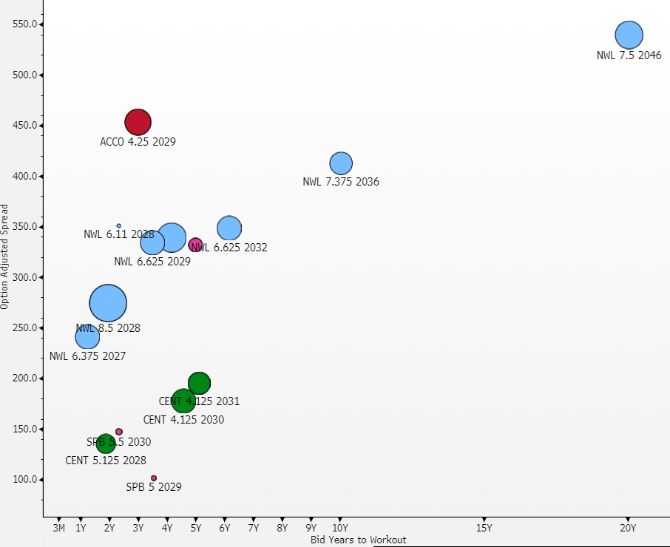
NWL Trades Wide to Comps
Source(s): Bloomberg, FactSet, Company Filings

Slide 19
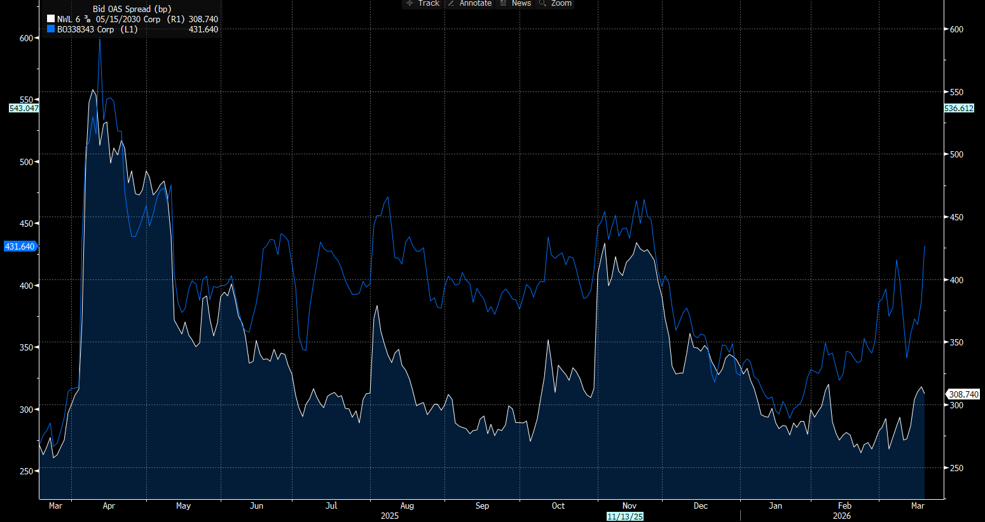
NWL vs ACCO 29s
Source(s): Bloomberg, FactSet, Company Filings

Slide 20
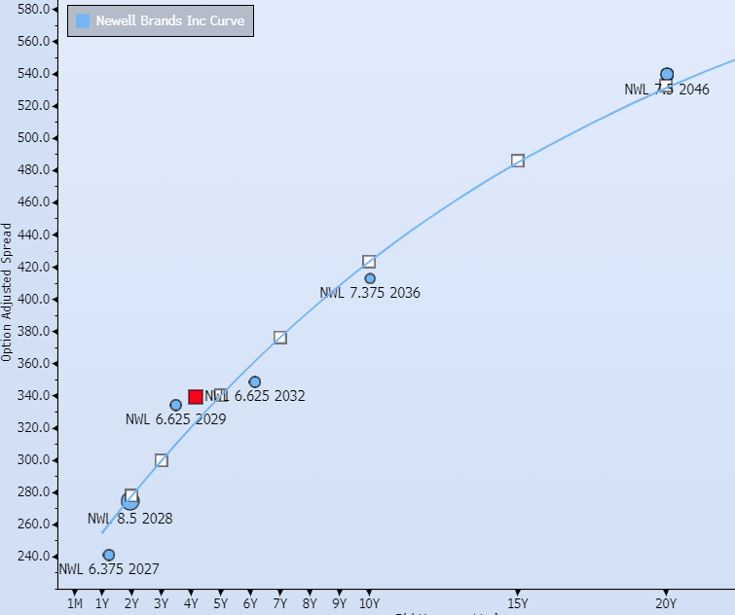
NWL Issuer Curve
Source(s): Bloomberg, FactSet, Company Filings

Slide 21
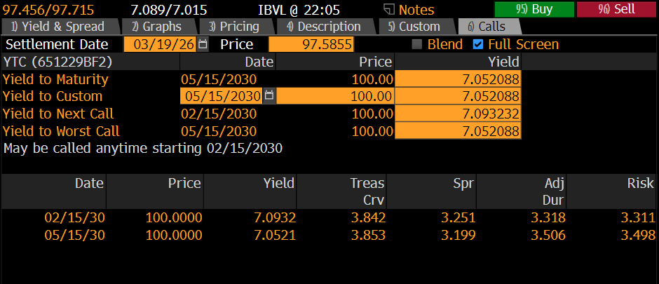
Call Scenario
Source(s): Bloomberg, FactSet, Company Filings

Slide 22
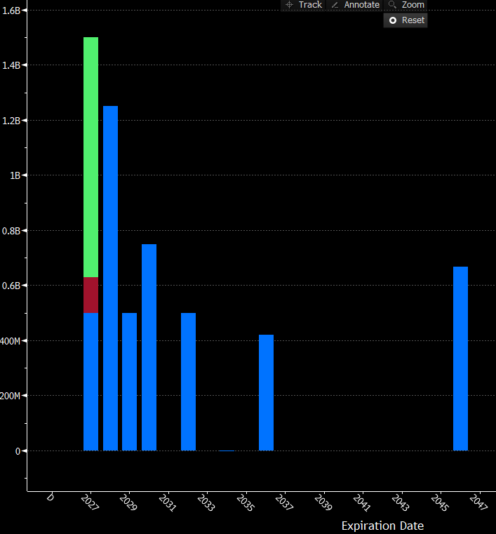
DDIS Screen
Source(s): Bloomberg, FactSet, Company Filings

Slide 23
Management
Chris Peterson (59)
Chief Executive Officer and President
Previous COO of Operations at Revlon Inc., and 20 years at Procter and Gamble.
Earned BS in Operations Research & Industrial Engineering from Cornell.
Mark Erceg (55)
Chief Financial Officer
10 years of prior CFO work at Tiffany & Co., Canadian Pacific Rail, and Masonite International.
Earned BS in Accounting & MBA in Finance from Indiana University.
CFA member
Source(s): Bloomberg, FactSet, Company Filings

Slide 24
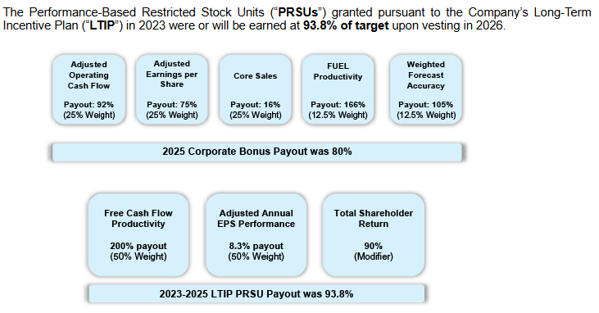
Management Compensation FY25
Source(s): Bloomberg, FactSet, Company Filings

Slide 25
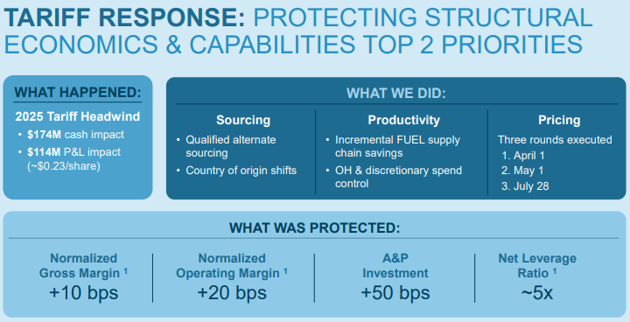
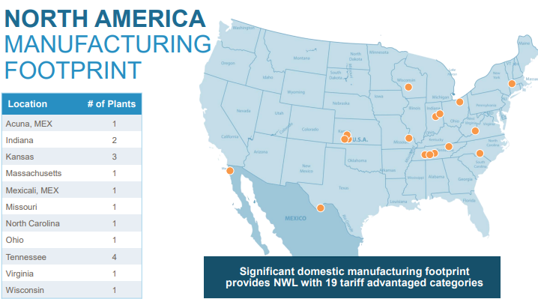
Tariff Impacts
Source(s): Bloomberg, FactSet, Company Filings

Slide 26
Income Statement
Source(s): Bloomberg, FactSet, Company Filings

Slide 27
Cash Flow Statement
Source(s): Bloomberg, FactSet, Company Filings

Slide 28
Balance Sheet
Source(s): Bloomberg, FactSet, Company Filings

Slide 29
Liquidity Model
Source(s): Bloomberg, FactSet, Company Filings

Slide 30
Capital Structure
Source(s): Bloomberg, FactSet, Company Filings

Slide 31
Credit Statistics
Source(s): Bloomberg, FactSet, Company Filings

